Slide 1
PyTHON FOR DATA ANALYSIS
Léonard Baesen & Sébastien Buquet / DIA 1

Slide 2
Problem
Can we predict the readmission of a diabete patient with the given dataset?
We decided to study this issue because the dataset was about the readmission of hospitalized diabetic patient in the USA
Link to dataset:
UCI Machine Learning Repository: Diabetes 130-US hospitals for years 1999-2008 Data Set

Slide 3
Treatment of DATA

Slide 4
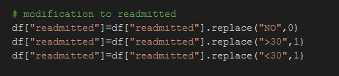
Main Variable
We decided to choose this variable as our data focus on whether the patients are readmitted to the hospital depending on the data.
This variable has three categories : not readmitted, readmitted under thirty days and readmitted after thirty days. We decided to study only the fact that they are readmitted or not. It is indeed clearer, easier to understand and to analyse.

Slide 5
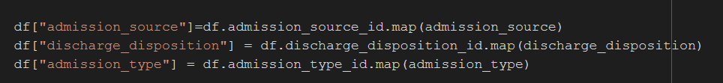
Mapping
With the data set was also given an other file containing the signification of the columns admission source, discharge disposition and admission type. We use it to create new columns that corresponds with already existing data. We use this mapping only in the visualization part of the dataset because it was not interested to use it in the machine learning. It would have added categorical value that would have needed to be encoded. Moreover we already had the variables in the dataset that were quantitative variables.

Slide 6
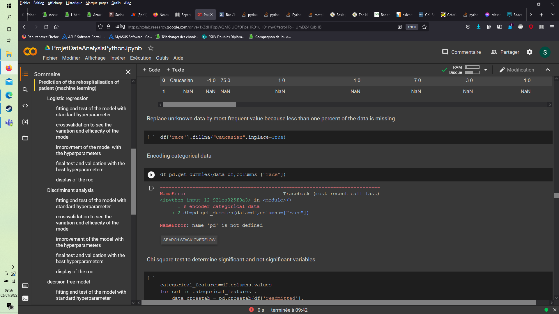
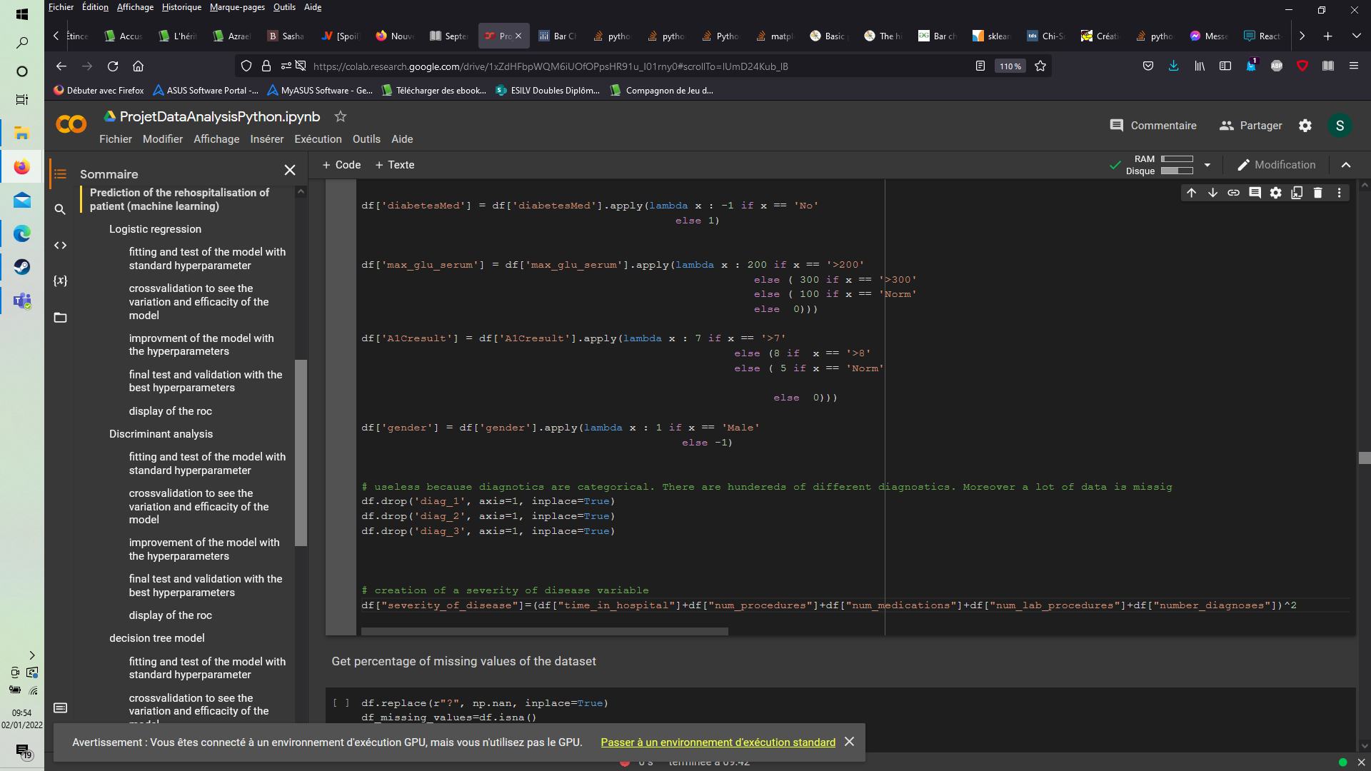
Creation of variables
We have two different kinds of data created:
- variables created by the encoding of an exisiting qualitative variable
- variables created by the linear product of other variables

Slide 7
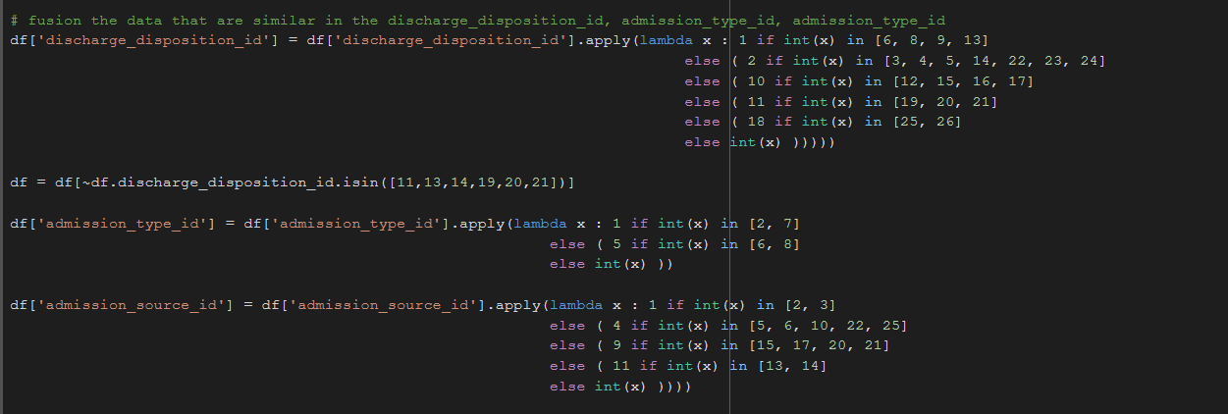
Cleaning the dataSET: mapping
We decided to group several similar modalities inside the variables in order to make it more understandable for the reader. For example, the categories 6, 8, 9 and 13 all correspond to an hospitalization at home with limited differences.

Slide 8
Cleaning the dataSET
We had several categrocial variables with only two choices. We decided in that case to tranform it in -1 or 1. This tranformation was applied on gender, change and diabetesMed

Slide 9
Cleaning the dataset: variables dropped
Several reasons to drop variables:
- the variable was nearly empty.
- the variable was not interesting because it was purely administrative data that has no links with our target
- the variable was unusuable because too complex
- the variables didn't pass the ki 2 test.

Slide 10
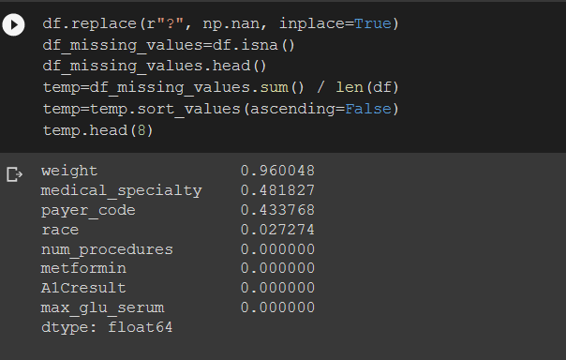
Cleaning the dataset: variable nearly empty.
Weight had only 4% of known data. Same for medical speciality and payer code that had 52% and 57% of known data. It was not significative enough to keep them.

Slide 11
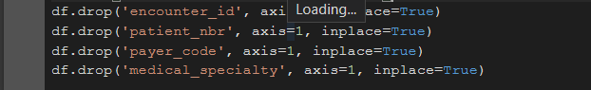
Cleaning of the data: administrative variable
Variable was not interesting because it was purely administrative data that has no links with our target

Slide 12
Cleaning of the dataset: the variables were unusuable because too complex
The variables were unusuable because too complex
- They were too many different modalities (diagnostics) and when we tried to encode them, It created more than than 4000 new variables.
- There was a lot of data missing on these variables: more than ten percent.
- We didn't find explicitely what diagnostic could be regrouped together
=> We decided to drop diag1, diag2, diag3 for these reasons.

Slide 13
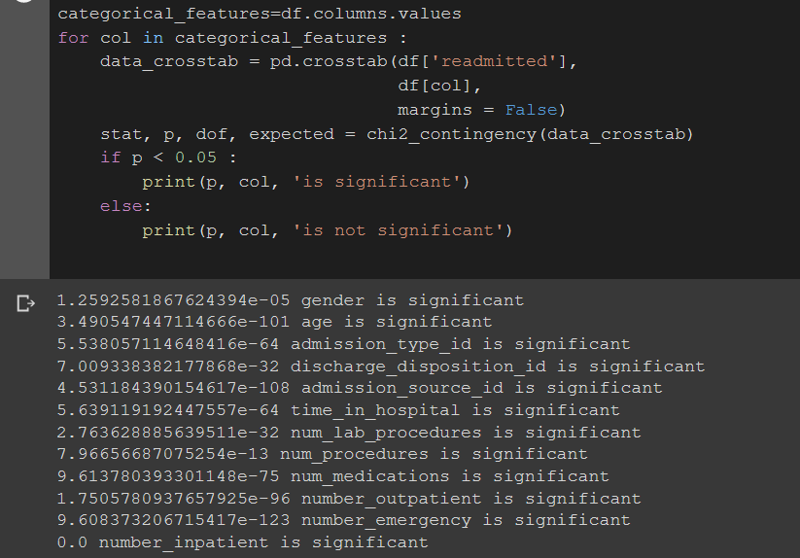
Cleaning of the dataset: khi-SQUARE test.
We decided to realize a khi-square test to see the links between variables and see the significant variables. We decided to take an eliminatory p-value of 5% and we dropped all the variables that were not significatif enough.

Slide 14
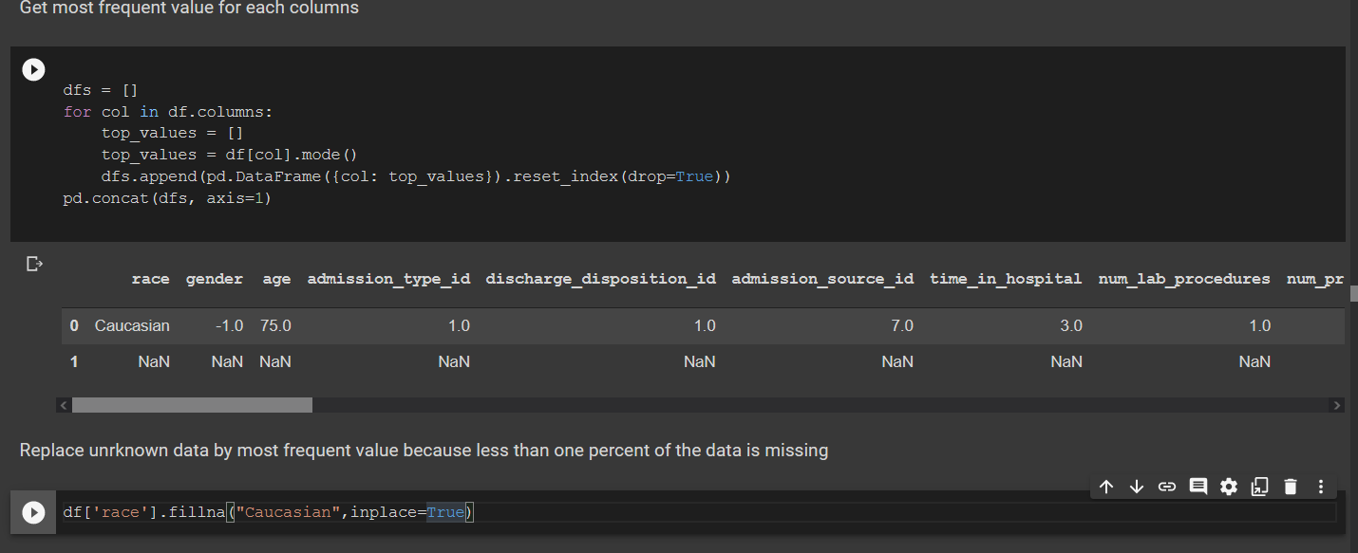
Replace unknown data by most frequent value ON VARIABLE WITH LESS THAN five PERCENT MISSING DATA
The only variable left with missing data was the race variable, we complete the missing data by the most present value that is caucasian.

Slide 15
MACHINE LEARNING

Slide 16
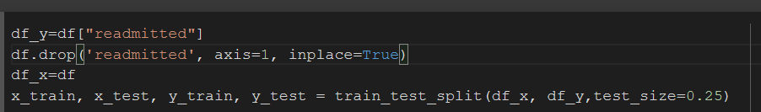
Split of the dataset
For the sake of the sklearn library we split the dataset in two with one dataset containing the target variable (readmitted) and one dataset containing the predictive variables. We then split these two new dataset in two to create the test and test parts. Here the test contained 25% of the total modalities.

Slide 17
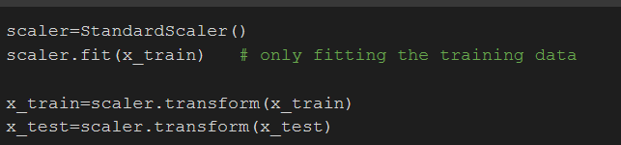
Fitting the DATA
We decided to fit the data to impove the precision of our machine learning algorithms. We only the training dataset that contains all the variables used to predict.

Slide 18
ALGORITHMS PRCOESS
I use several machine learning algorithms to predict the readmission of a patient.
I made a process that I repeat for each of the algorithm:
- I use the standard method to fit and score. I do this to test the algorithm.
- I apply a grid search to adjust the hypermparameters
- I relaunch my function with the new parameters
- I display the ROC and the AUC to give a visual overview of the result

Slide 19
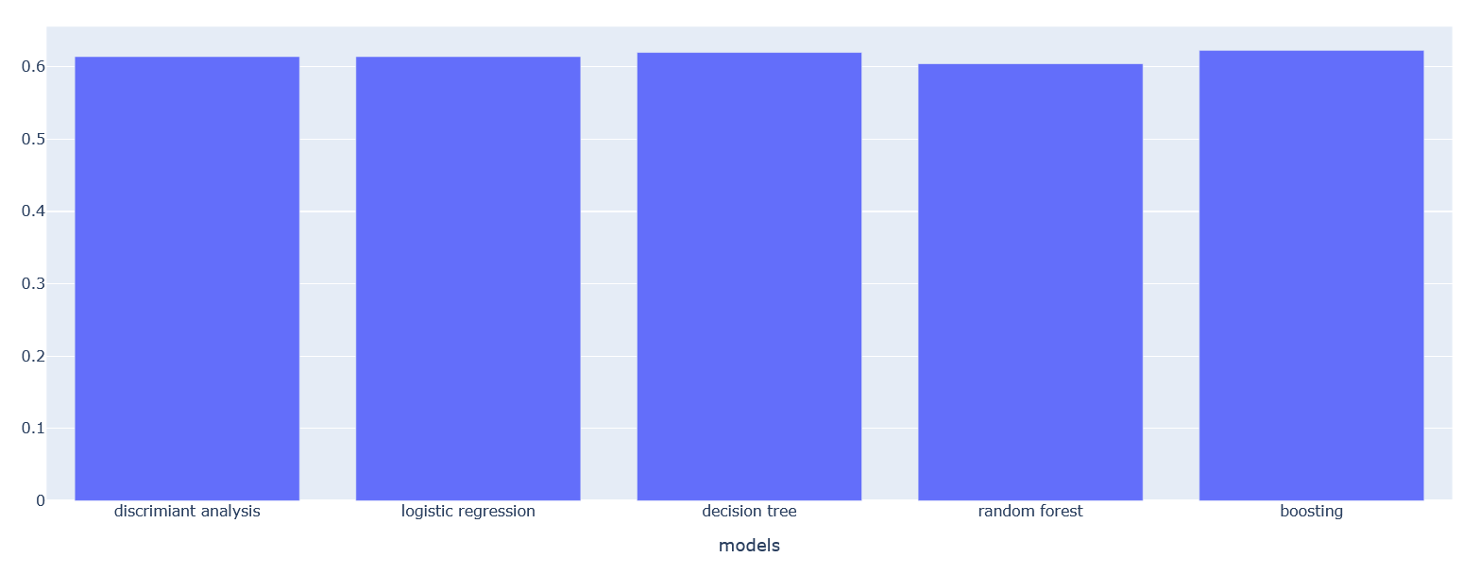
RESULTS
As we can see from this graphic, the different models have very similar predictive capacity in this case. But the boosting that is known for its resilience to overfitting is still the best with more than one percent.

Slide 20
Flask

Slide 21
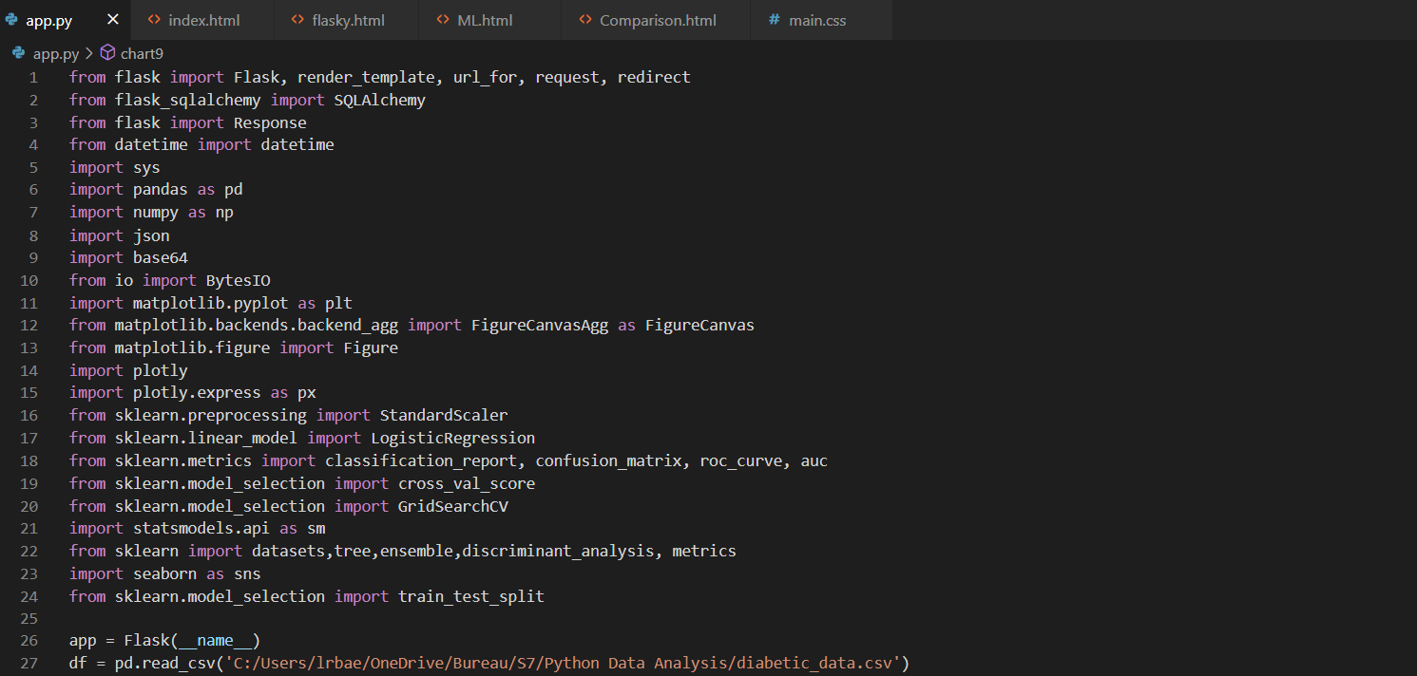
Flask
We decided to use Flask to learn a new tool.
We coded it on Visual Studio Code because it is really convenient to code in different programmation laguages such as Python, HTML or CSS.

Slide 22
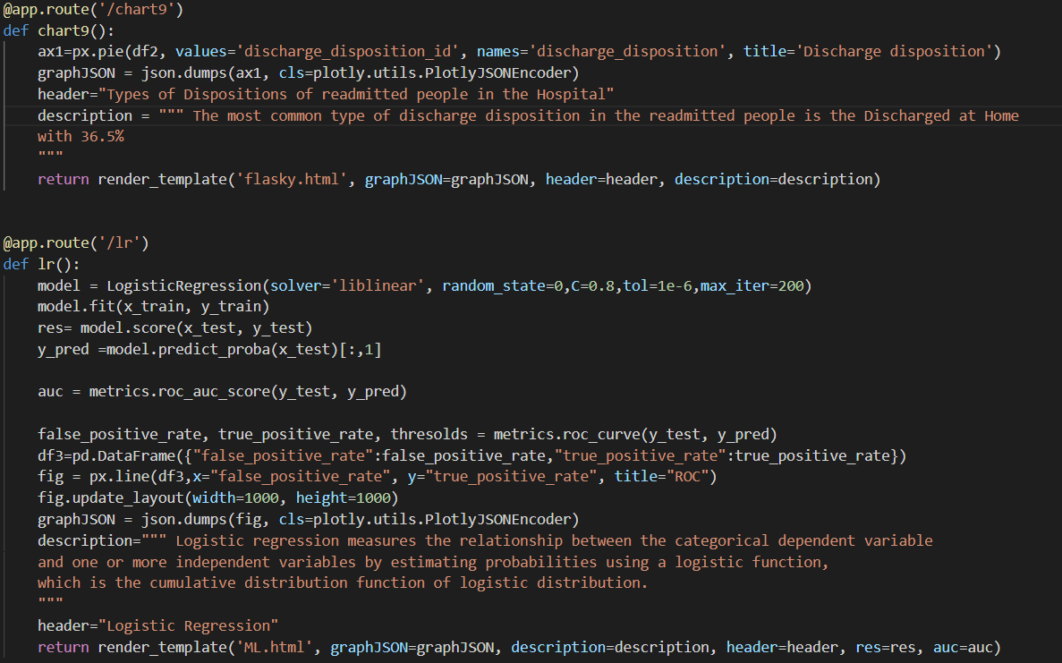
App.py
We have a python file called app.py with the all the coding to visualize the data, clean the data and do the machine learning.
The visualizations and machine learning models are in different seperate functions we can called after in the html.
On the right :
- The chart9 function to plot a pie chart
- The linear regression model function

Slide 23
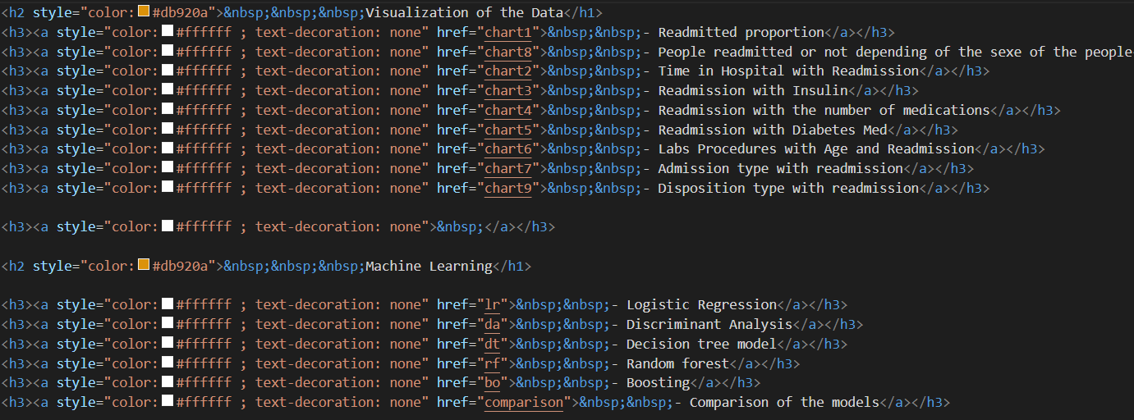
Index.html
The file index.html is the first page on the local website.
It is the « table of contents » where you can choose which visualization you want to see or which score of model of machine learning you want to know.
Each functions are called in the index.

Slide 24
Main page

Slide 25
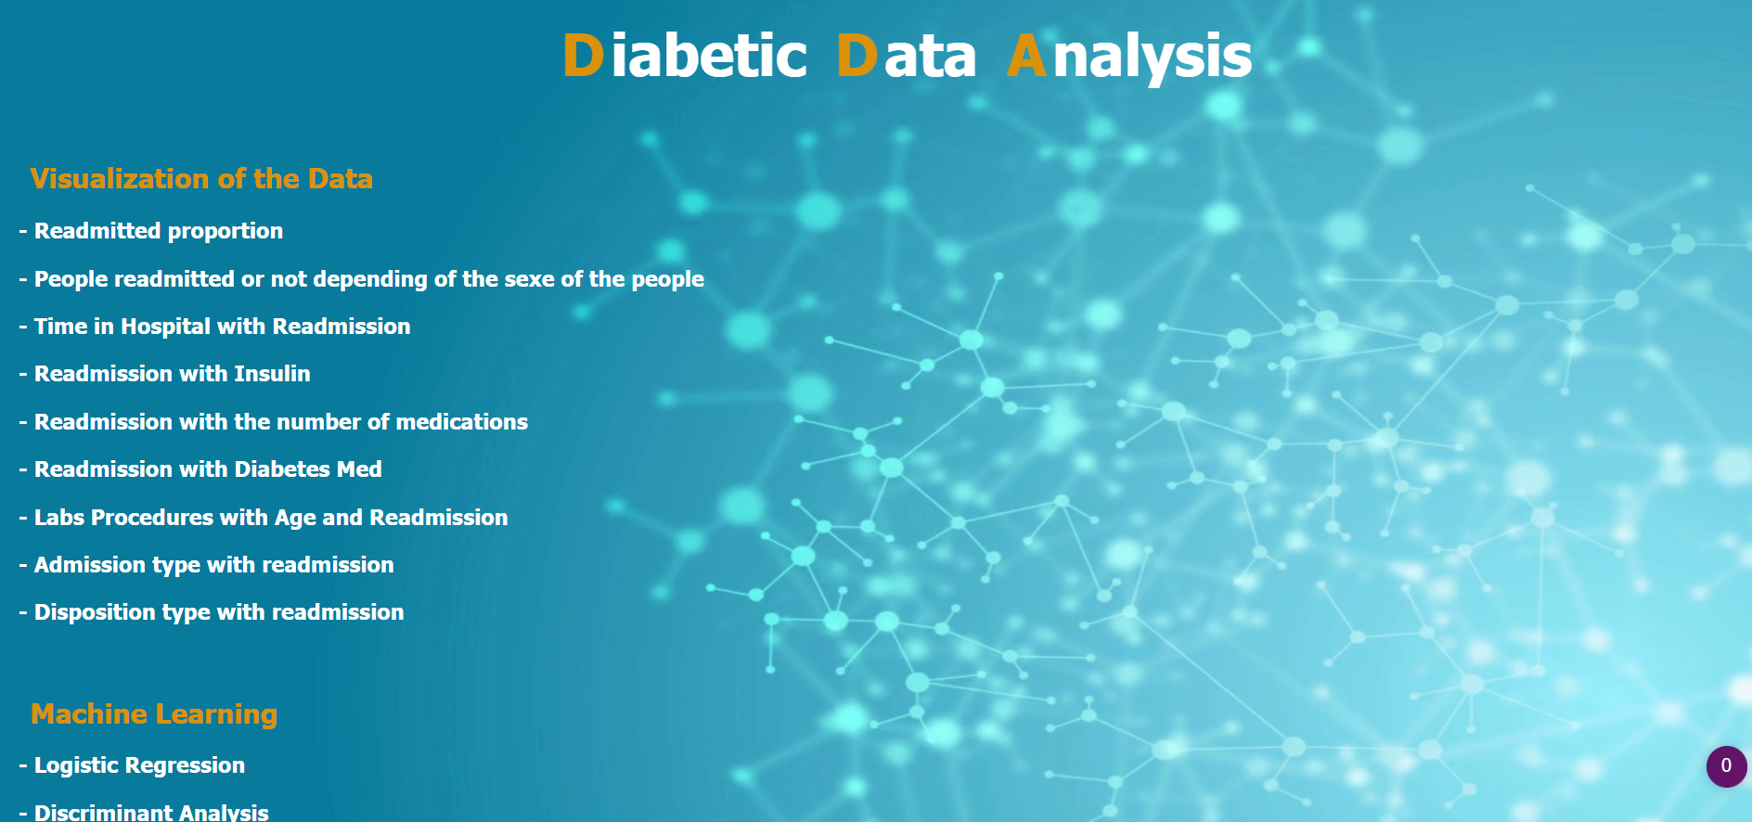

Slide 26
Exemple of Visualization

Slide 27
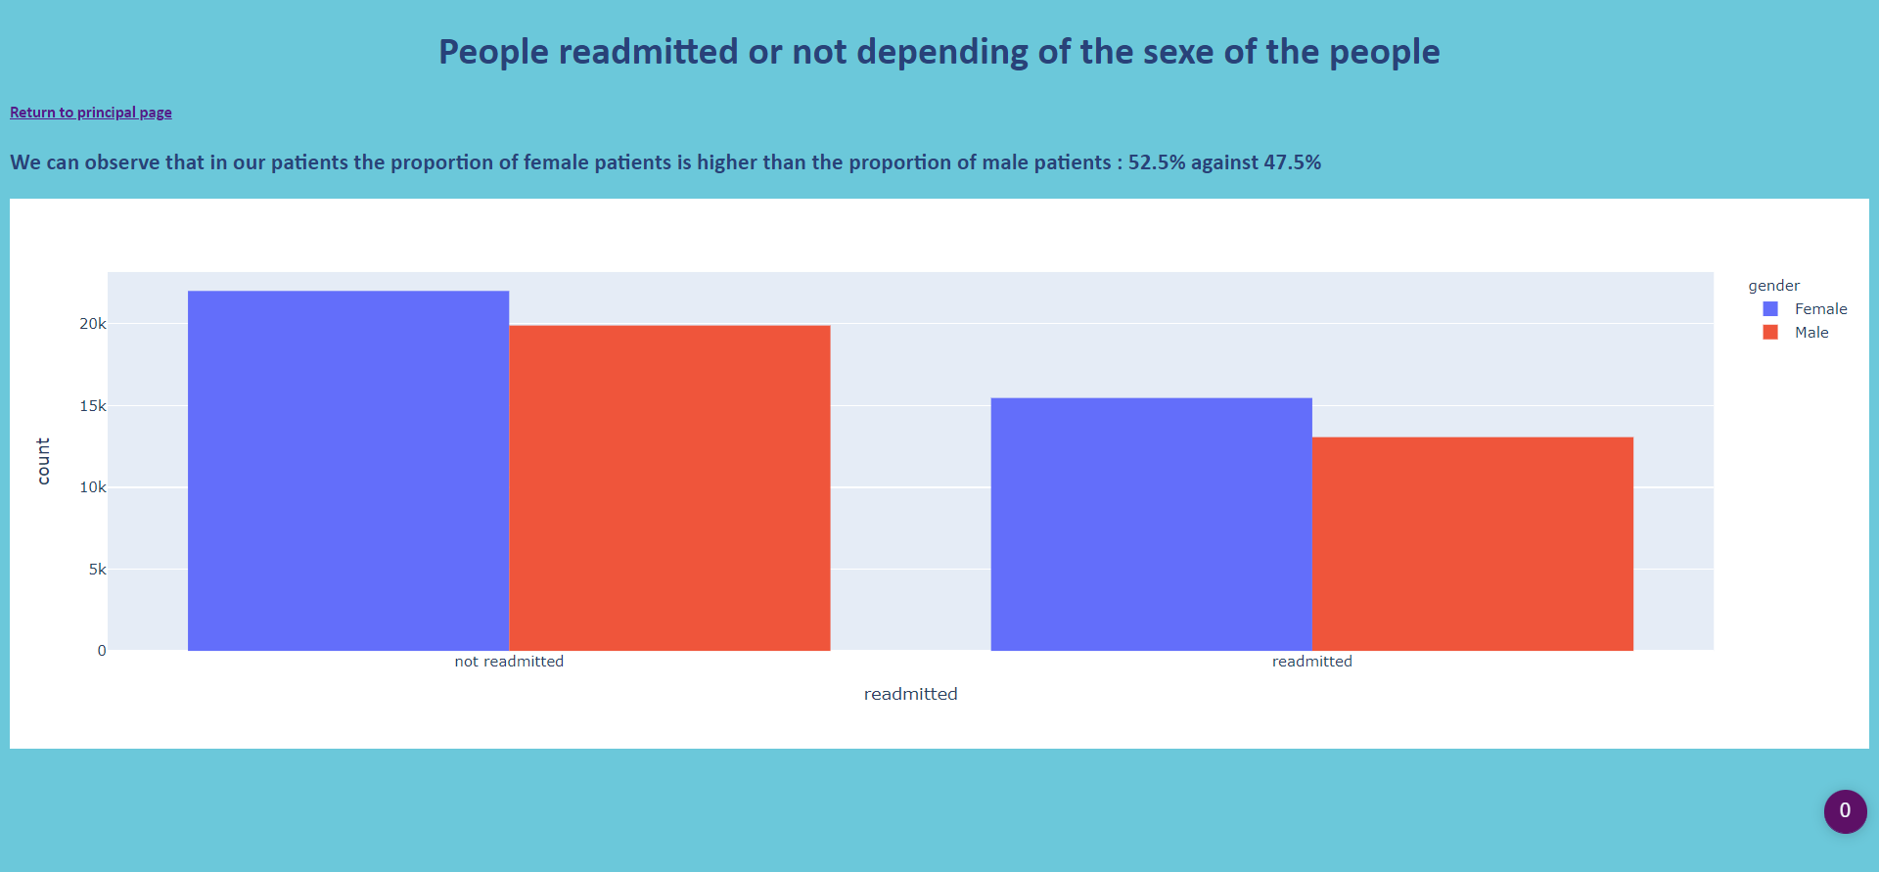

Slide 28
Exemple of ML model

Slide 29
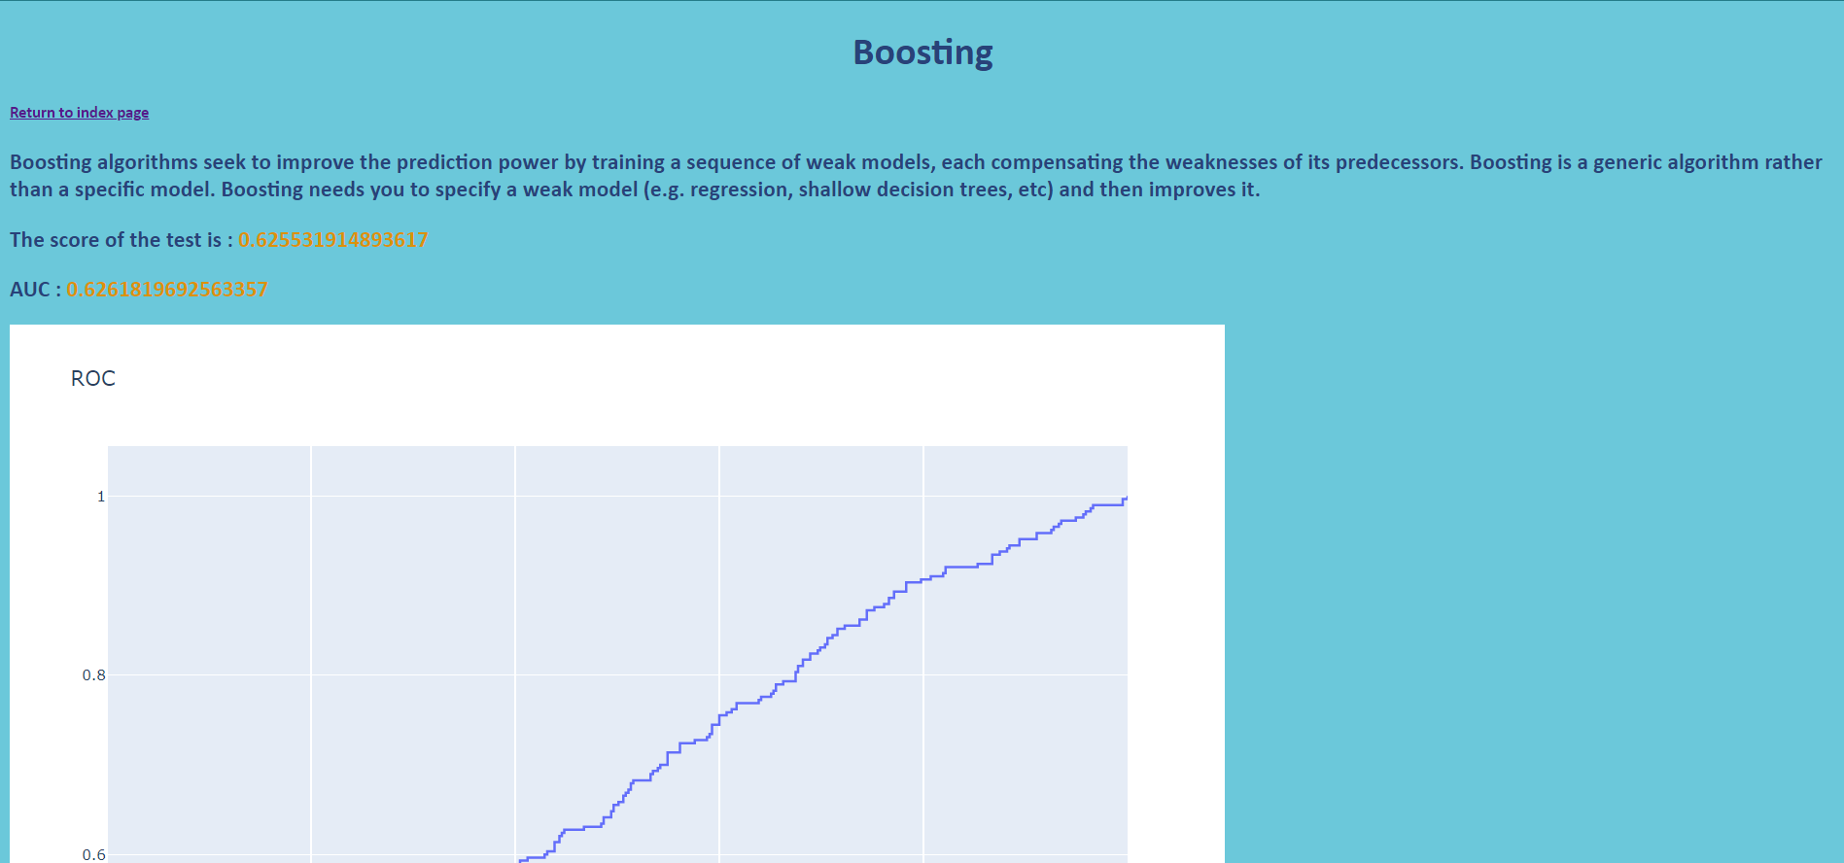

Slide 30
Exemple of API

Slide 31
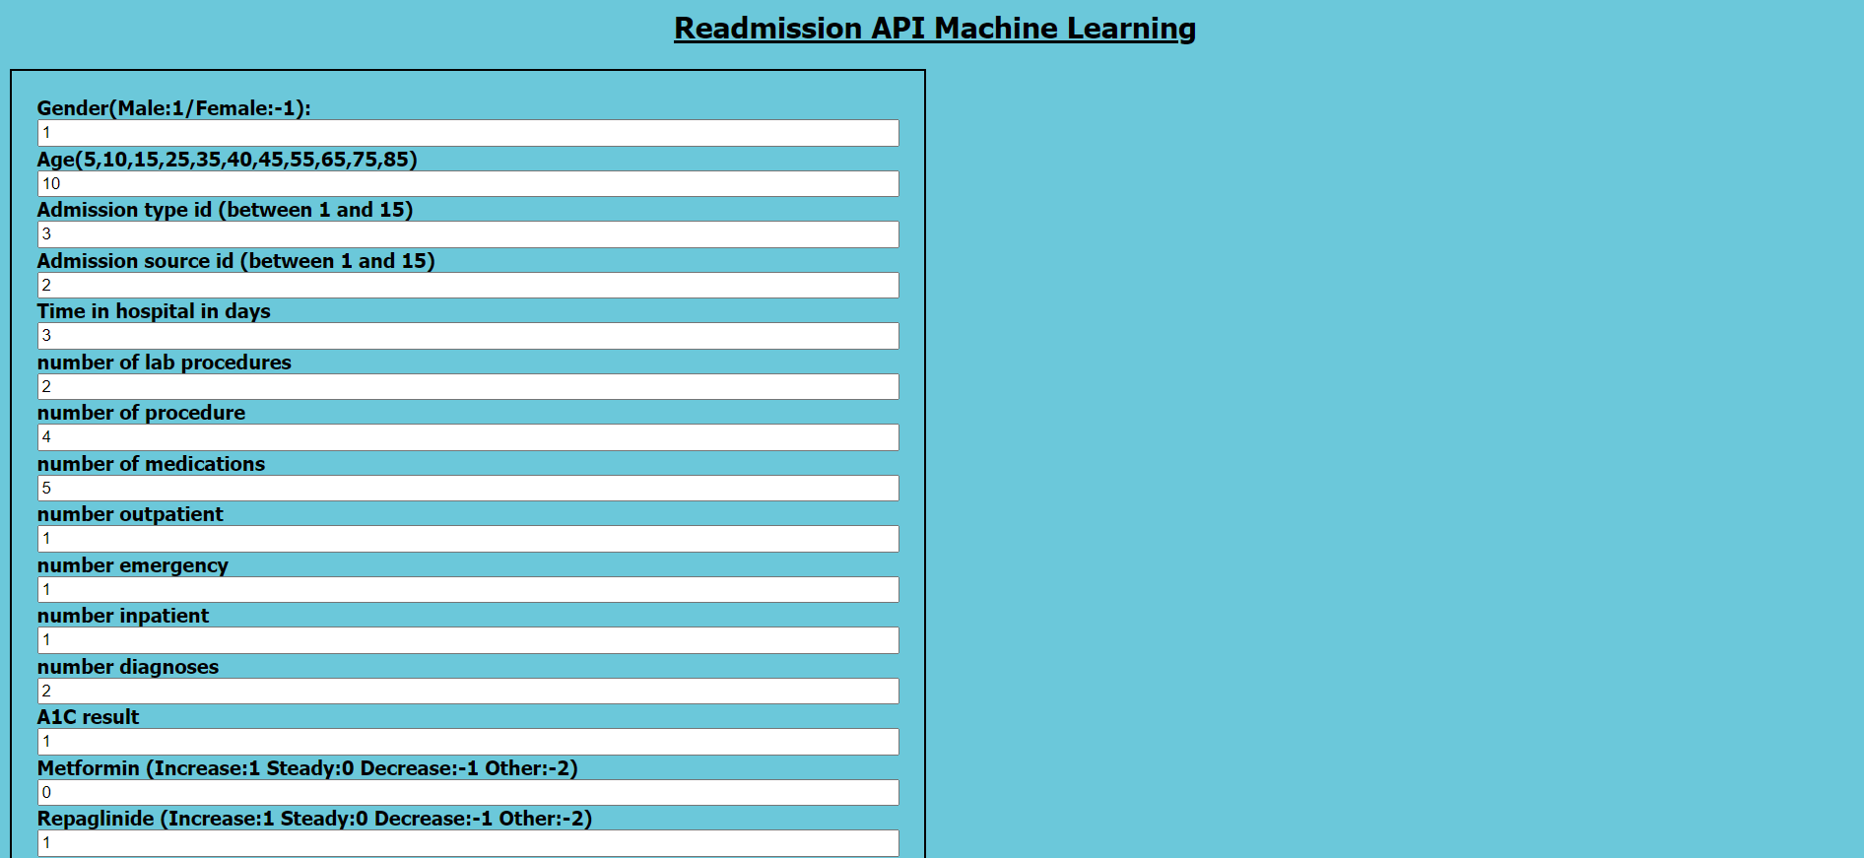
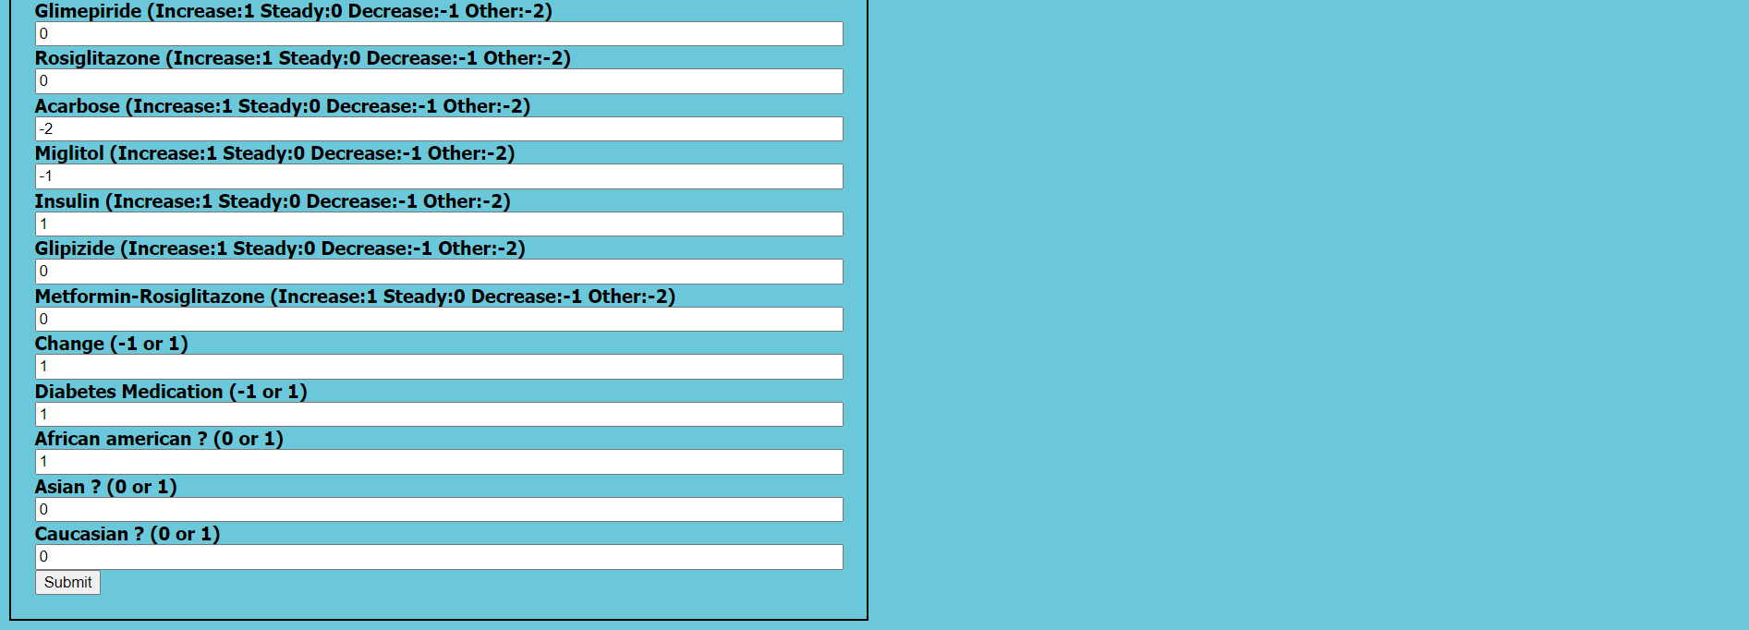

Slide 32


Slide 33
CoNCLUSION
Out of the several analysis that produce results on similar kinds of dataset, the maximum predictivites observe were between 60 and 70 % for readmission at hospital.
The max we got was 64% percent with the boosting algorithm.

